Slide 1
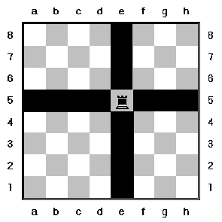
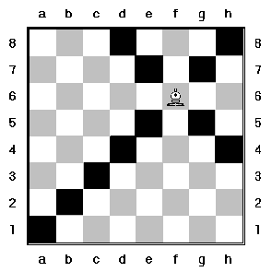
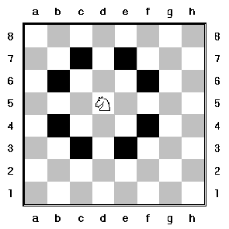
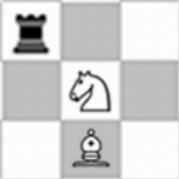
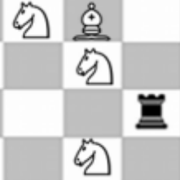
Problem:
Using only rooks, knights, and bishops on an MxN matrix, find the maximum number of pieces you can place on the board such that no pieces can attack any other piece.
Output for this grid would be:
3 3 RNNNKNNBN
Programs will be judged as a calculation as follows:
- (Your number/maximum * 70) + (fastest/your speed * 30) for a max of 100.
- Program with the highest total wins
Output for this grid would be:
4 3 KBNNKNNNRNKN
To Test:
www.sfmaddogs.com/internproblem.html

